Slide 1
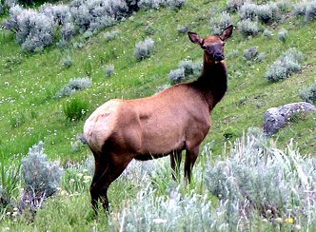
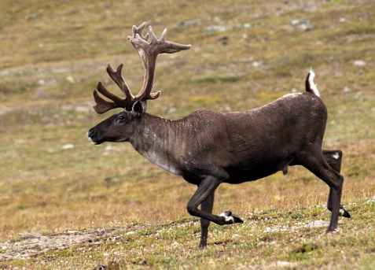
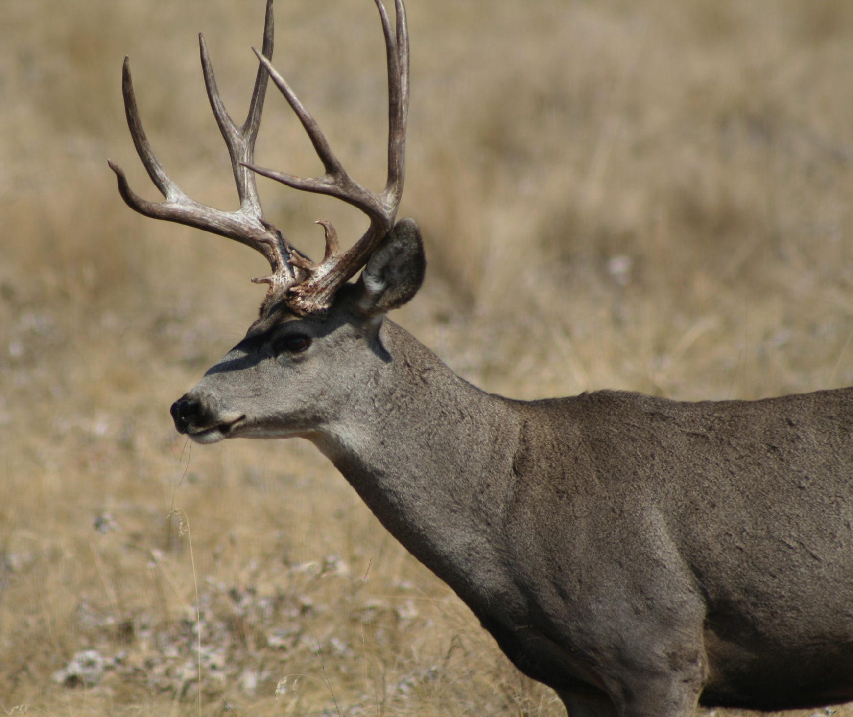
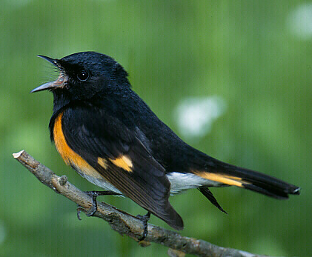
Global population dynamics and climate change: Comparing species-level impacts on (two contrasting) large mammals (?)
Mark Hebblewhite^{1*}, Eric S. Post², Farshid Ahrestani², Bill Smith², Steven W. Running¹, Maosheng Zhao¹ ¹University of Montana, ²Pennsylvania State University

Slide 2
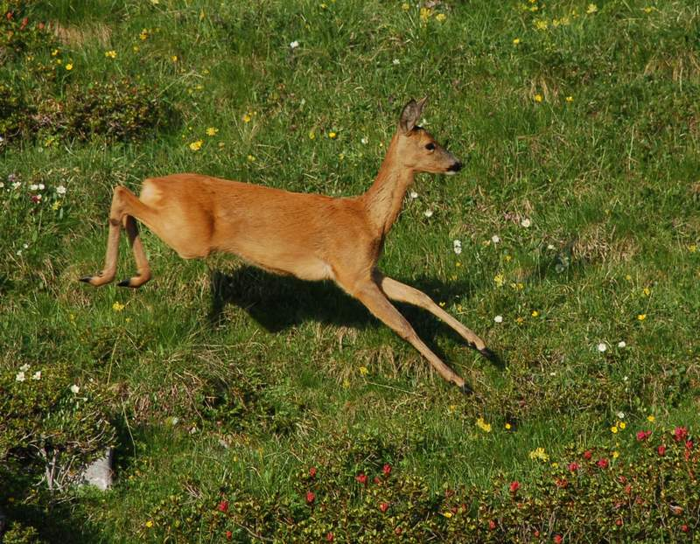
Roe Deer

Slide 3
Global population dynamics and climate change: Comparing species-level impacts on (two contrasting) large mammals
Question: How does climatic influence vary across a species’ range and globally after accounting for biotic interactions?
Approach: Global Population Dynamics Approach (Post et al. 2009, Bioscience)
Methods:
Niche Modeling with climate, landuse, fire
Population dynamics models using time series models with climate , vegetation indices, biotic interactions
Link population and niche models at species range scale

Slide 4
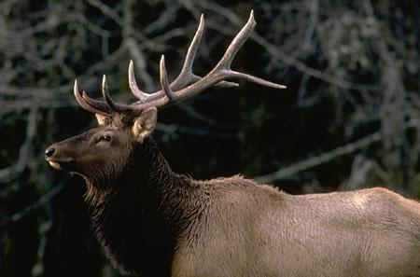
Outline
Summary of work on Rangifer and Cervus dynamics
Strengths and limitations of time-series of N?
2. Mule Deer – Functional PCA of NDVI
and climate
3. Elk – time-series of survival and
recruitment
4. Summary

Slide 5
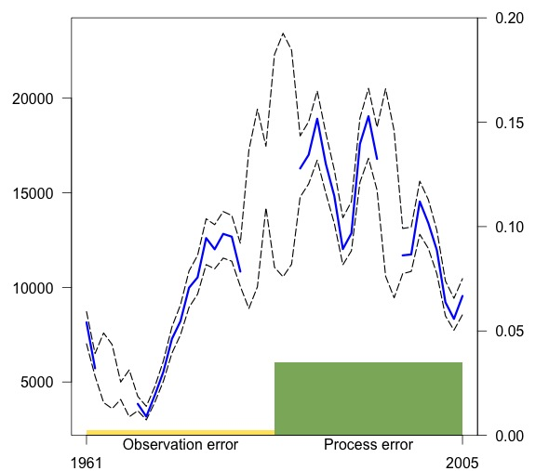
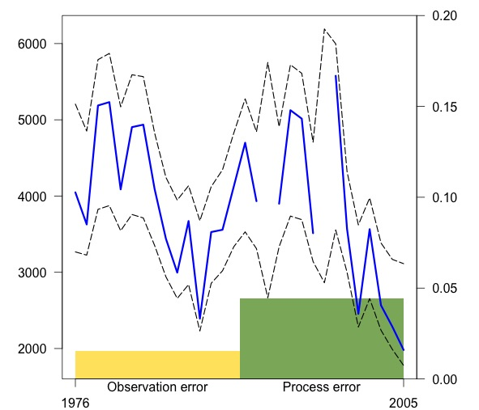
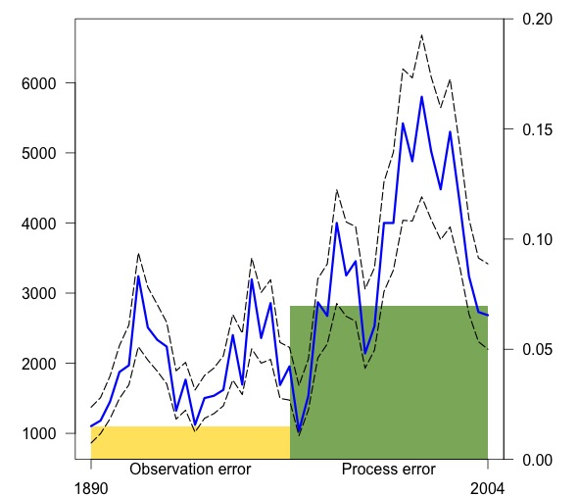
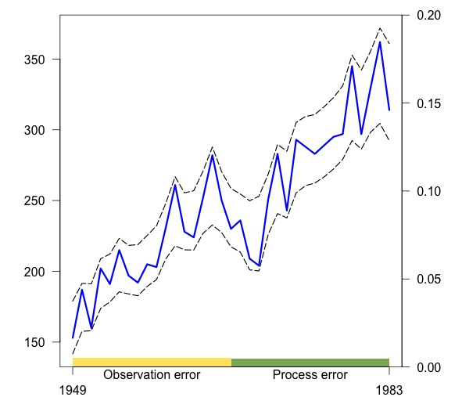
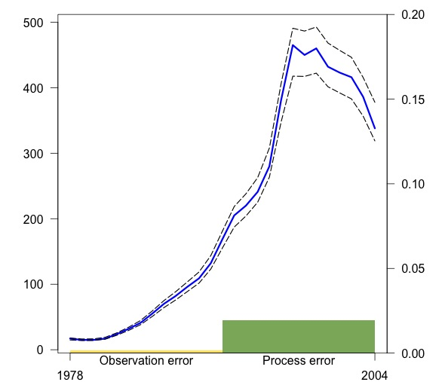
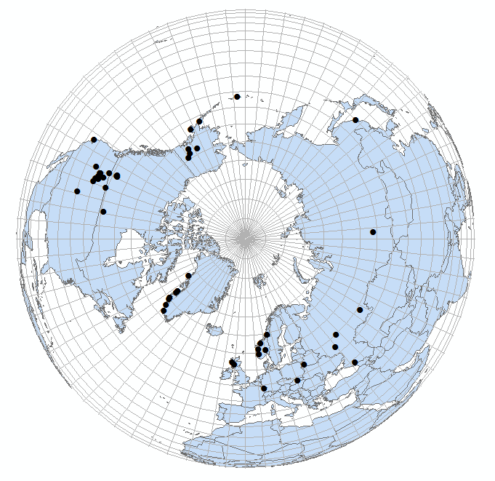
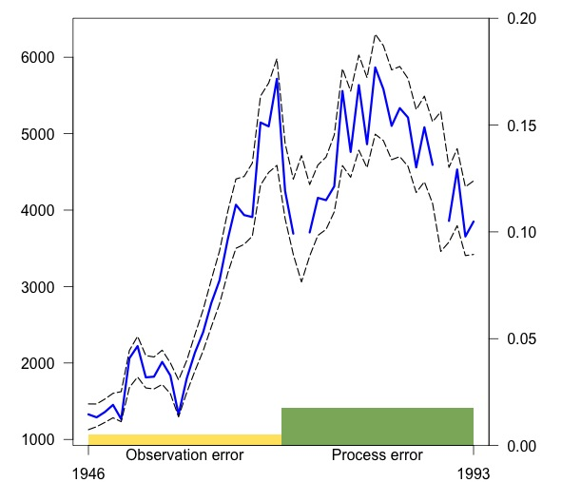
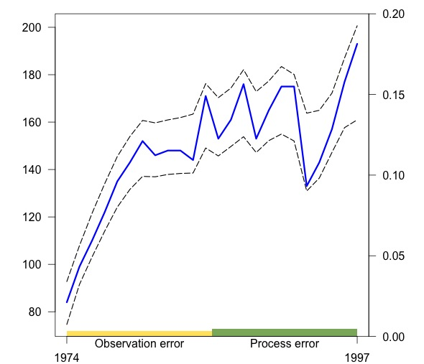
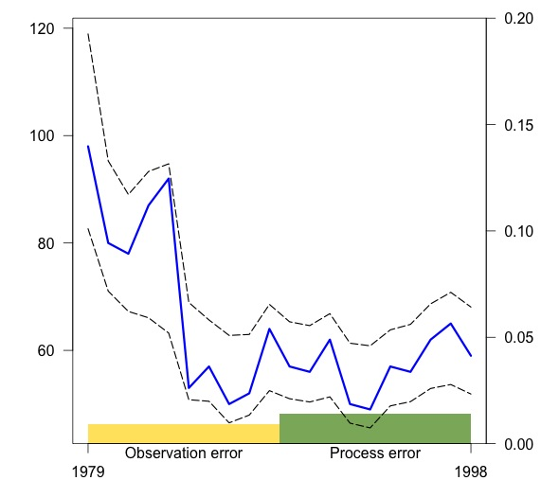
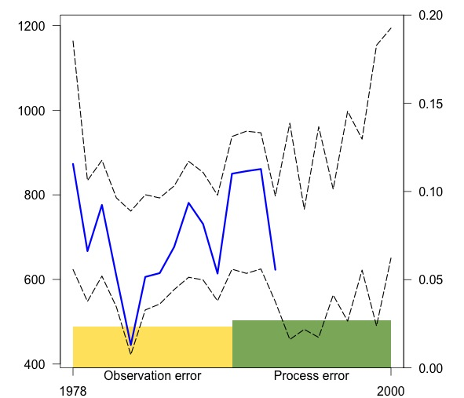
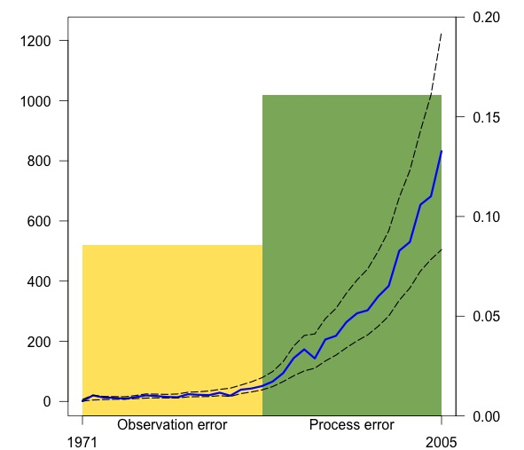
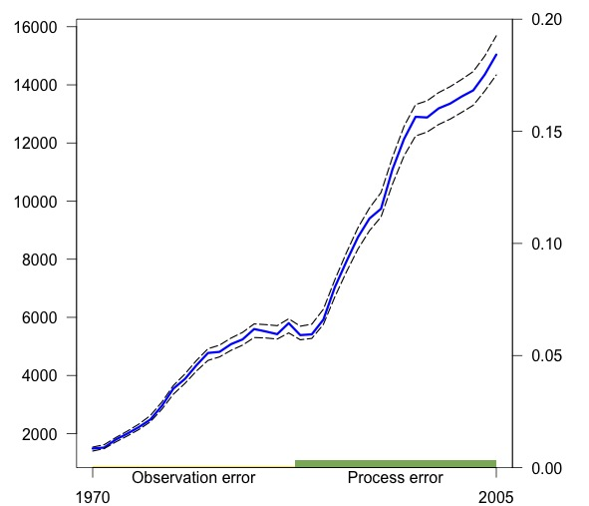
Cervus elephas
Ahrestani et al. (2013)
Scientific Reports

Slide 6
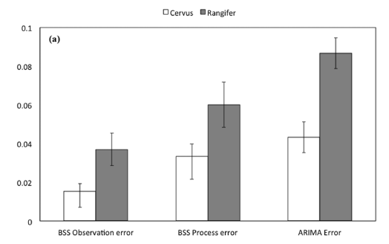
Time Series Data
²
Caribou time-series data quite ‘noisy’
Acknowledgement: This study was funded
by NASA grant NNX11AO47G
Acknowledgement: This study was funded
by NASA grant NNX11AO47G

Slide 7
Time-Series Conclusions
The most stable dynamics were observed in populations experiencing:
negative trends in the variation in vegetation productivity (declining NDVI)
positive departures from long-term mean annual temperature (later springs, shorter growing season)
The most UNSTABLE population dynamics were observed in populations experiencing:
Increasing trends in vegetation productivity (increasing NDVI)
Negative departures from long-term mean annual temperatures (earlier springs, shorter growing season)

Slide 8
Time-Series Conclusions
Utility of wildlife time-series data at broad spatial scales is challenging
E.g., caribou poor precision, high uncertainty in counts being meaningful
Some species – higher quality – currently examining trends in spatial autocorrelation in climate drivers using BBS bird data
Ability to understand mechanism of how climate impacts driving population dynamics are limited.
Move to a population modelling approach

Slide 9
Outline
Summary of work on Rangifer and Cervus dynamics
Strengths and limitations of time-series of N?
2. Mule Deer – Functional PCA of NDVI
and climate
3. Elk – time-series of survival and
recruitment
4. Birds - trends in autocorrelation of population trends

Slide 10
Mule Deer & Global Change
Time-series of demographic traits – moving beyond time-series data
Mule deer overwinter survival a key demographic trait of mule deer
Semi-arid systems – Fall phenology more variable? How does climate and NDVI drive overwinter survival?
Can we use NDVI to predict population dynamics?

Slide 11
Mule Deer & Global Change
Time-series of demographic traits – moving beyond time-series data
Mule deer overwinter survival a key demographic trait of mule deer

Slide 12
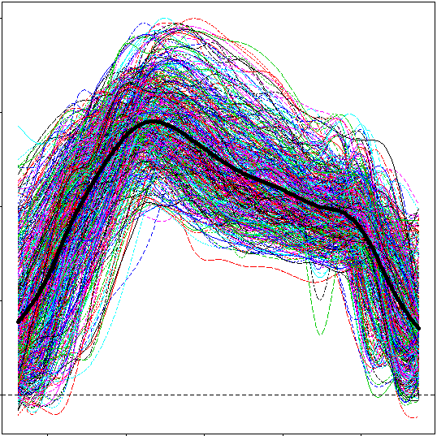
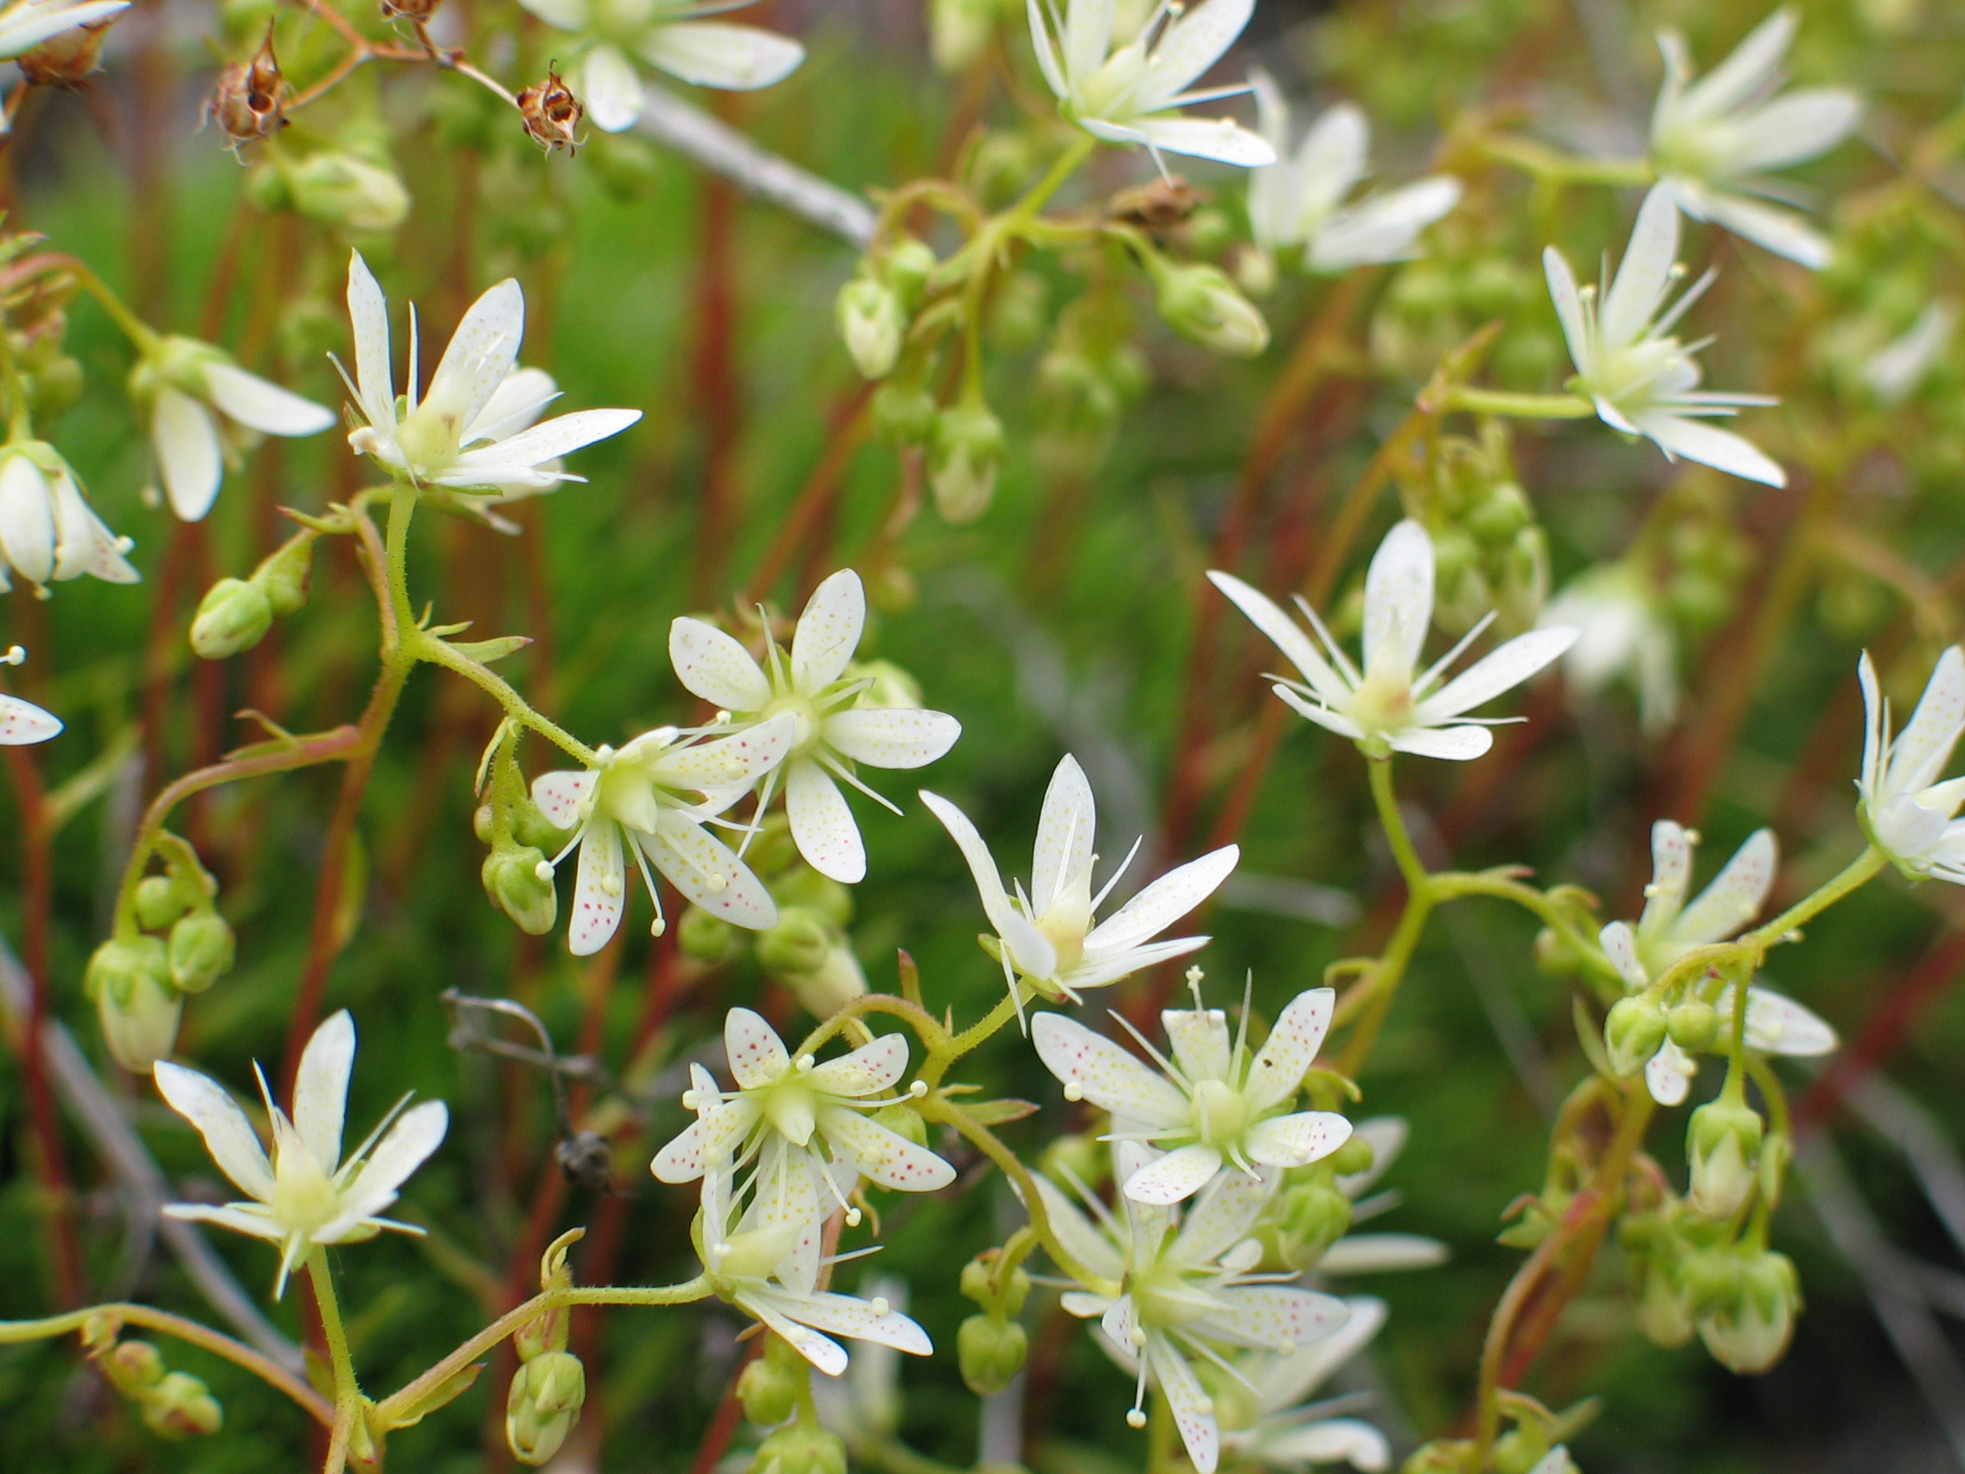
Functional PCA
Most analyses of NDVI use summary statistics; mean, SD, etc. in animal ecology studies
TIMESAT extracts beginning, end, peak, etc. – all correlated
Standard PCA ignores temporal component of NDVI data – equivalent to assuming weeks (MODIS periods) are independent
Developed novel application of Functional PCA to NDVI data

Slide 13
Functional PCA
FPCA is a form of Functional Data Analysis (Ramsay & Silverman 2005, Ramsay et al. 2009)
Few ecological or remote sensing examples? (Embling et al. 2012)
Three main steps: 1) Definition of the basis functions, 2) Smoothing of the observed curves, and 3) Summarizing the variation in the curves.
Ramsay R, Silverman BW. 2005 Functional data analysis. New York, NY: Springer.
Ramsay JO, Hooker G, Graves S. 2009 Functional data analysis with R and MATLAB. New York, NY:
Springer.
Embling CB, et al. 2012. J. Appl. Ecol. 49, 481–492.

Slide 14
Functional PCA
Code & sample data for FPCA available on PTRSB special issue
Email corresponding author or myself

Slide 15
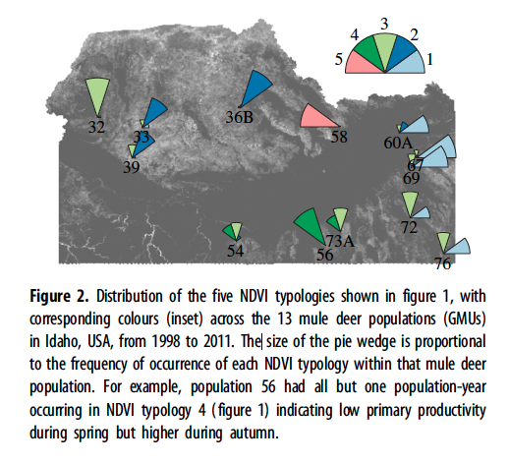
Mule Deer Study Area
Idaho, 1998 – 2011
Thirteen Game Management Units (GMU’s) spanning a wide geographic gradient of 160,000km²
Annual variation in population dynamics driven by overwinter fawn survival
2,315 mule deer fawns captured in late Fall/Early Winter
MODIS NDVI, EVI, Snow cover
PRISM weather data

Slide 16
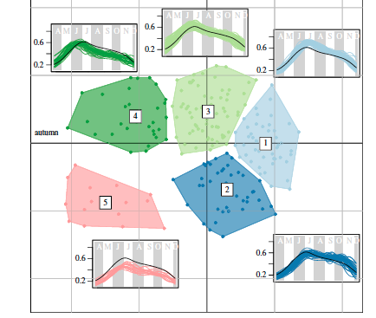
FPCA & NDVI Typology

Slide 17
Mule Deer & Global Change

Slide 18
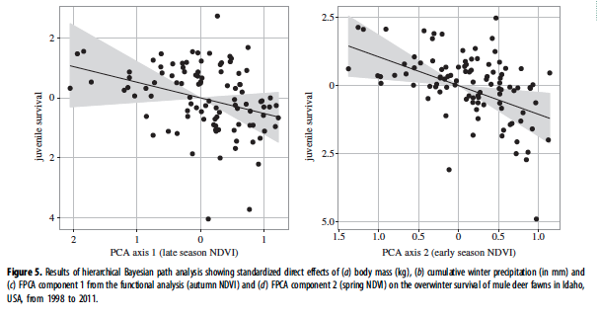
Mule Deer Overwinter Survival

Slide 19
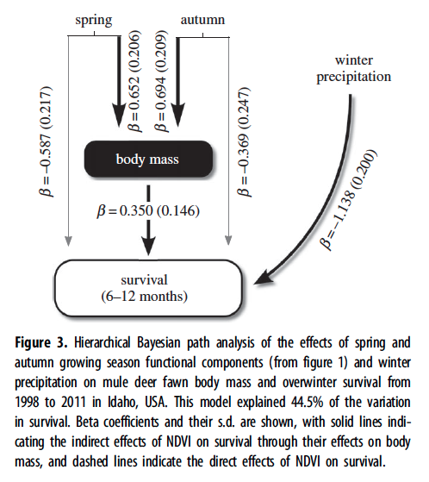
Mule Deer Summary

Slide 20
Mule Deer & Global Change
FPCA an important advance in how to extract information from the entire NDVI curve
Identified regions in which FALL versus SPRING phenology was the primary driver of overwinter survival
AREAS and SEASONS with the greatest temporal variance in phenology drove overwinter survival

Slide 21
Harvest Season Setting for year t+1 (Jan 1)
Winter in year t (Nov - Dec)
Overwinter survival
Recruitment into year t+1 (May)
MODIS Snow
Fall senescence in year t (Sept)
Fawn birth and spring green up in year t
Summer
(neonate survival)
Remote Sensing Data (NDVI, PCA1)
Remote Sensing Data (NDVI, PCA2)

Slide 22
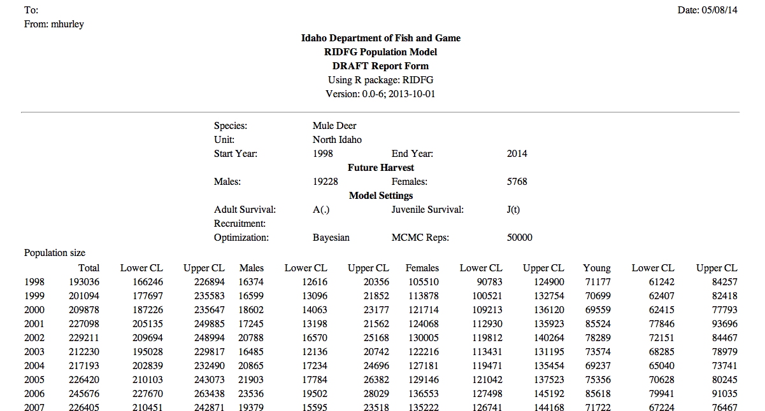
Mule Deer Population Dynamics

Slide 23
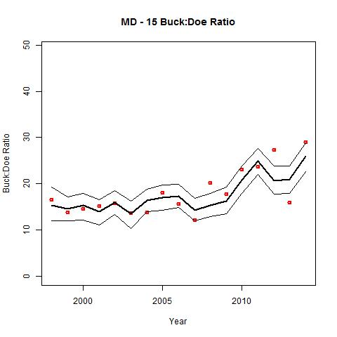
Mule Deer Population Dynamics

Slide 24
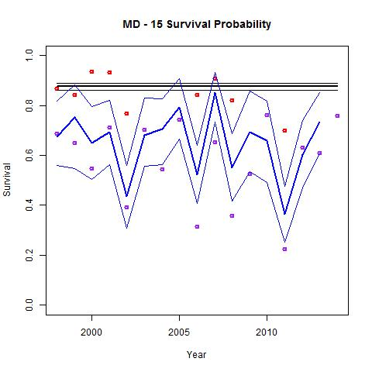
Mule Deer Population Dynamics

Slide 25
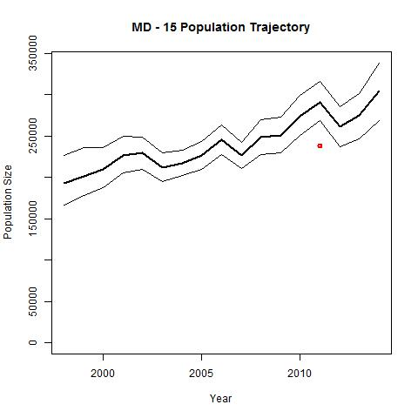
Mule Deer Population Dynamics

Slide 26
Mule Deer Population Dynamics
Bayesian Integrated Population Models build off state-space time-series models we developed for elk and caribou
Allow prediction in time and space with missing data (e.g., some units only have N, some fawn:doe ratio, etc)
Provide a framework for wildlife managers to incorporate effects of variation in climate (PRISM) and NDVI (MODIS) on population management

Slide 27
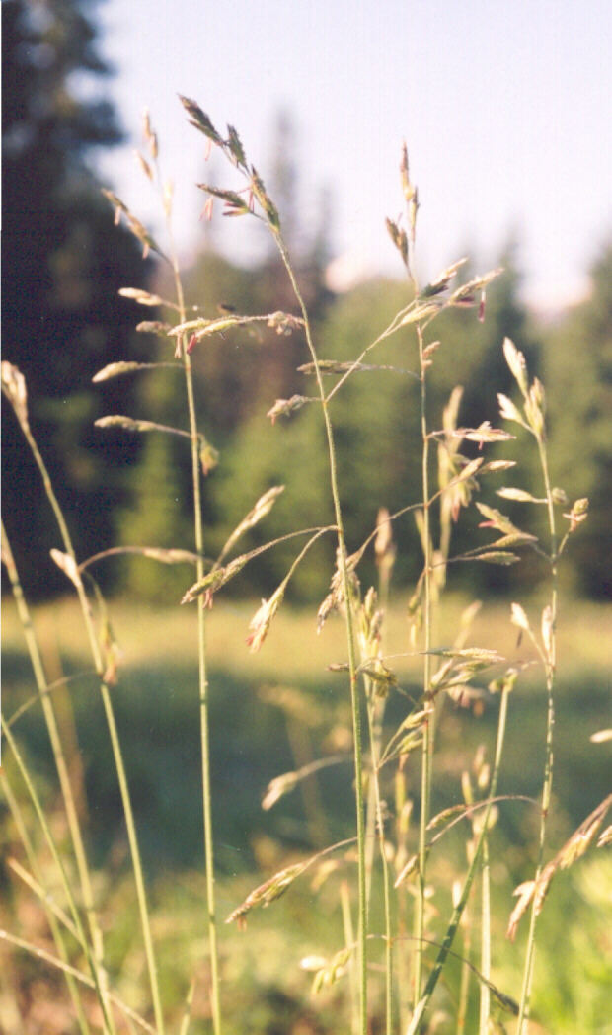
Elk Population Dynamics
Collect adult female elk survival and calf recruitment data across the Northwestern USA
Western Elk Research Collaborative (WERC)
ID, MT, WY, OR, CO, WA, UT
4. USGS – Coop unit funding key
5. Across our 45 study populations, we had data from 2746 individual adult female elk representing 9409 elk-years, with
1058 mortalities.

Slide 28
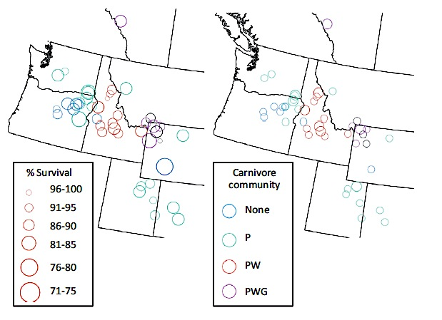
Elk Population Dynamics

Slide 29
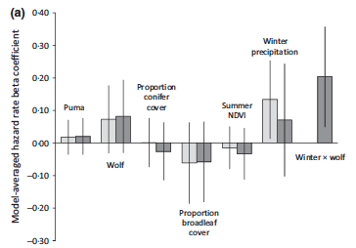
Elk Population Dynamics

Slide 30
Elk Population Dynamics
Adult female elk survival does not vary that much
Relatively insensitive to variation in summer growing season conditions
Much more sensitive to variation in winter climatic conditions.
Wolf X Winter severity interaction.

Slide 31
Elk Population Dynamics
Juvenile recruitment key to ungulate population dynamics
WERC lead
3. Calf:cow ratio
23 years 1989 - 2012
101 elk management units
1,512 unit-years
4. Climate (PRISM) and NDVI (growing season conditions)

Slide 32
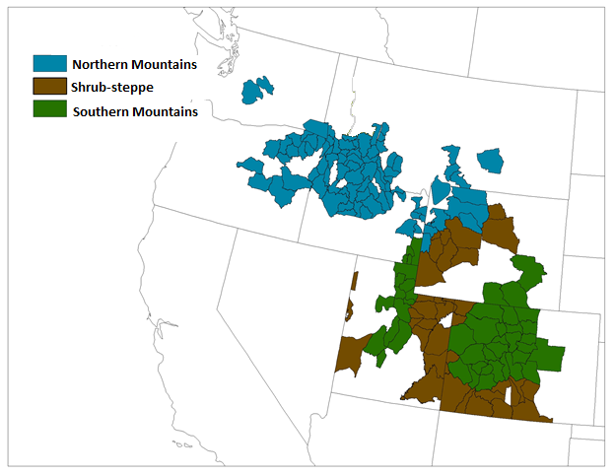
Elk Population Dynamics
Lukacs et al. (2015) In Review, J. Applied Ecology

Slide 33
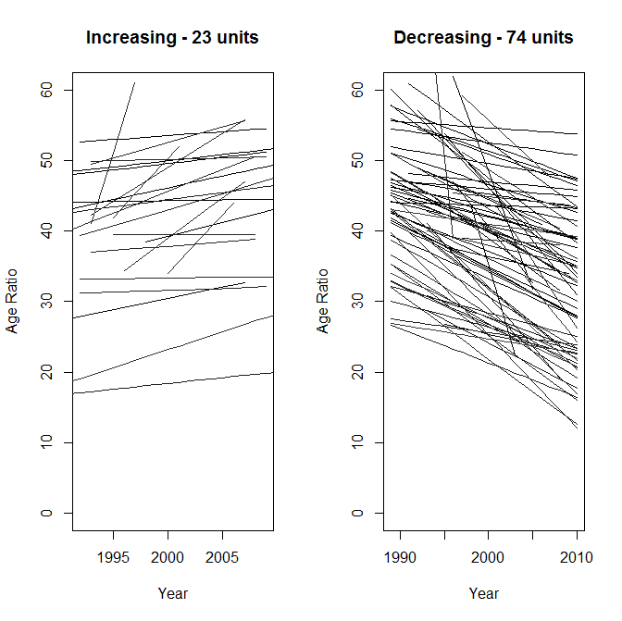
Elk Population Dynamics

Slide 34
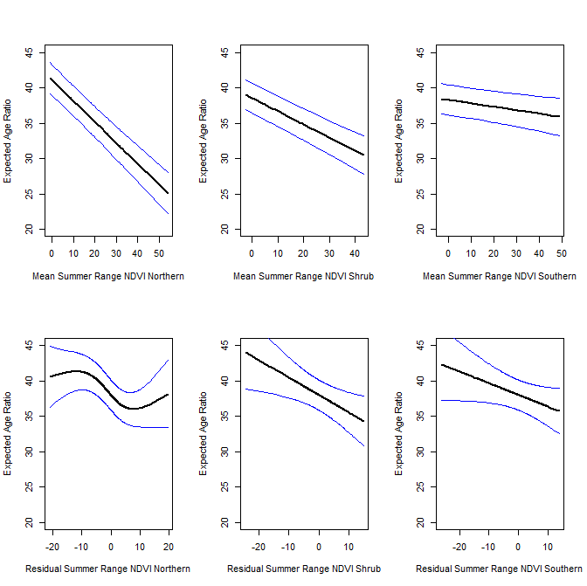
Elk Population Dynamics

Slide 35
Elk Population Dynamics
Juvenile recruitment MUCH more sensitive to variation in:
Climate (winter severity and summer precipitation)
NDVI measures of forage biomass and variation
Effects varied geographically across range of elk
Next steps IPM for elk

Slide 36
Summary
Large mammal time-series data is challenging to link mechanistically to climate drivers
e.g. caribou
Birds?
State wildlife agencies often collect higher quality data than N, yielding more ‘mechanistic’ insights into abiotic/biotic drivers
Final results to come!
- NDVI – forage quality from Idaho to Greenland

Slide 37
Publications
Ahrestani, F. S., W. K. Smith, M. Hebblewhite, S. W. Running, and E. Post. 2015. Density dependence and population stability at the species distribution scale. Oikos In Revision.
Ahrestani, F. S., P. S. Jorgenson, M. Hebblewhite, and E. Post. 2015. Temporal trends in the scale of spatial autocorrelation – A new frontier in monitoring population response to regional-level environmental change. Ecography In Review.
Ahrestani, F. S., M. Hebblewhite, and E. S. Post. 2013. The importance of observation versus process error in analyses of global ungulate populations. Scientific Reports 3:03125.
Hurley, M. A., M. Hebblewhite, J. M. Gaillard, S. Dray, K. A. Taylor, W. K. Smith, P. Zager, and C. Bonenfant. 2014. Functional analysis of Normalized Difference Vegetation Index curves reveals overwinter mule deer survival is driven by both spring and autumn phenology. Philos Trans R Soc Lond B Biol Sci 369:20130196.
Brodie, J., H. E. Johnson, M. S. Mitchell, P. Zager, K. M. Proffitt, M. Hebblewhite, M. Kauffman, B. Johnson, J. Bissonette, C. Bishop, J. A. Gude, J. Herbert, K. Hersey, M. Hurley, P. Lukacs, S. McCorquodale, E. McIntire, J. Nowak, D. W. Smith, and P. J. White. 2013. Relative influence of human harvest, carnivores and weather on adult female elk survival across western North America. Journal of Applied Ecology 50:295-305.
Peters, W., M. Hebblewhite, N. J. DeCesare, F. Cagnacci, and M. Musiani. 2012. Resource separation analysis with moose indicates threats to caribou in human altered landscapes. Ecography 35.
Ramler, J. P., M. Hebblewhite, D. Kellenberg, and C. Sime. 2014. Crying Wolf? A Spatial Analysis of Wolf Location and Depredations on Calf Weight. American Journal of Agricultural Economics 96:631-656.
Brodie, J., A. Giordano, B. G. Dickson, M. Hebblewhite, H. Bernard, J. Mohd-Azlan, J. Anderson, and L. Ambu. 2014. Evaluating multispecies landscape connectivity in a threatened tropical community. Conservation Biology 29:122- 132.
Post, E. S., E. Bhatt, C. Bitz, J. Brodie, T. L. Fulton, M. Hebblewhite, J. Kerby, S. Kutz, I. Stirling, and D. A. Walker. 2013. Sea ice as a driver of ecological responses to climate change in the Arctic. Science 341:519 - 524.
Greene, L., M. Hebblewhite, and T. R. Stephenson. 2012. Short-term vegetation response to wildfire in the eastern Sierra Nevada: implications for recovering an endangered ungulate. Journal of Arid Environments 87:118 - 128.
DeCesare, N. J., M. Hebblewhite, D. Hervieux, M. Bradley, and M. Musiani. 2014. Linking resource selection and predation risk to a spatially explicit model of habitat quality. Journal of Animal Ecology 83: 343–352.
Weckworth, B. V., M. Musiani, N. J. DeCesare, A. McDevitt, M. Hebblewhite, and S. Mariani. 2013. Preferred habitat and effective population size drive the landscape genetics of an endangered ungulate. Proceedings of the Royal Society B-Biological Sciences 280:20131756.
Polfus, J. L., K. Heinemeyer, M. Hebblewhite, and T. R. T. F. Nation. 2014. Comparing traditional ecological knowledge and western science woodland caribou habitat models. The Journal of Wildlife Management 78:112-121.
Goldberg, J. G., M. Hebblewhite, and J. Bardsley. 2014. Consequences of a Refuge for the Predator-Prey Dynamics of a Wolf-Elk system in Banff National Park, Alberta, Canada. PLoS One 9:e91417.
Hebblewhite, M. 2013. Consequences of ratio-dependent wolf predation on elk population dynamics. Population Ecology 55:511-522.

